Slide 1
Image Adversarial Attack
DeepFool & JSMA
Mengdie Huang
2020/06/15

Slide 2
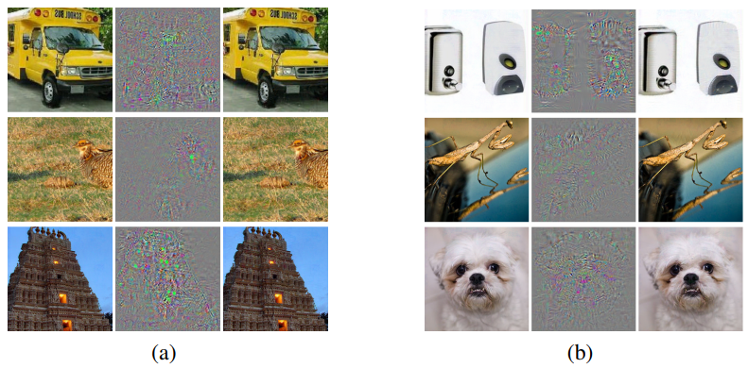
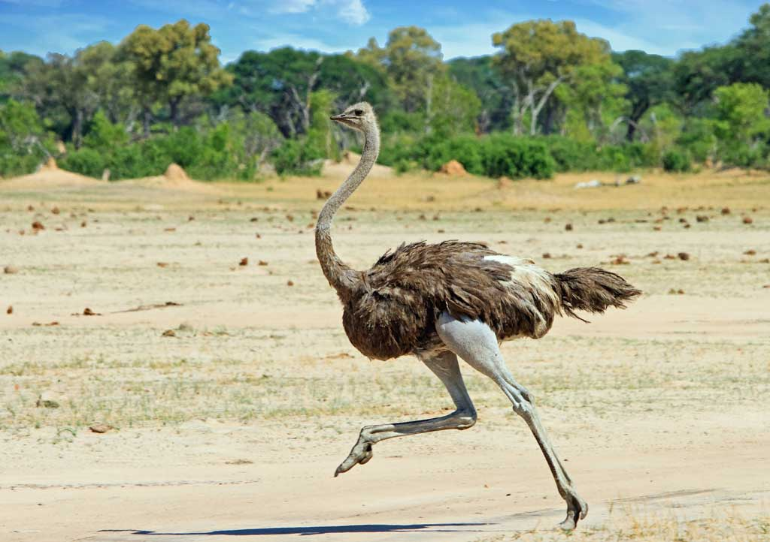
Adversarial Attack
Clean
Example
Average
Distortion (X10)
Adversarial
Example
Clean
Example
Average
Distortion (X10)
Adversarial
Example
All images in the right column are predicted to be an “ostrich, Struthio camelus”
How to select the pixel for distorting?
How to distort the selected pixels?
非洲鸵鸟（学名：Struthio camelus）属鸵形目鸵鸟科

Slide 3
L-BFGS（2013.12.21）[Optimization]
FGSM（2014.12.20）[Cost Function Gradient]
DeepFool（2015.11.14）[Cost Function Gradient]
JSMA（2015.11.24）[Function Gradient]
BIM（2016.7.8）[Cost Function Gradient]
CW（2016.8.16）[Optimization]
Prior Work
How to find the adversarial distortion?

Slide 4








Prior Work
L-BFGS（2013.12.21）[Optimization]
FGSM（2014.12.20）[Cost Function Gradient]
DeepFool（2015.11.14）[Cost Function Gradient]
JSMA（2015.11.24）[Function Gradient]
BIM（2016.7.8）[Cost Function Gradient]
CW（2016.8.16）[Optimization]

Slide 5
Prior Work
L-BFGS（2013.12.21）[Optimization]
FGSM（2014.12.20）[Cost Function Gradient]
DeepFool（2015.11.14）[Cost Function Gradient]
JSMA（2015.11.24）[Function Gradient]
BIM（2016.7.8）[Cost Function Gradient]
CW（2016.8.16）[Optimization]

Slide 6
Team
Paper 2016CVPR DeepFool a simple and accurate method to fool deep neural networks
Author Seyed-Mohsen Moosavi-Dezfooli
Team École Polytechnique Fédérale de Lausanne, EPFL（瑞士）
Others 2017CVPR Universal adversarial perturbations
Paper 2016EuroS&P The Limitations of Deep Learning in Adversarial Settings（JSMA）
Author Nicolas Papernot
Team University of Pennsylvania，Upenn（费城）
Others 2016S&P Distillation as a Defense to Adversarial Perturbations against Deep Neural Networks
2016Asiaccs Practical Black-Box Attacks against Machine Learning
Jacobin-based Saliency Map Attack

Slide 7
DeepFool
DeepFool
Binary Classifier
DeepFool
Iteration DeepFool
Multiclass Classifier
Linear Model
Nonlinear Model
Linear Model
DeepFool
Iteration DeepFool
https://arxiv.org/abs/1511.04599

Slide 8
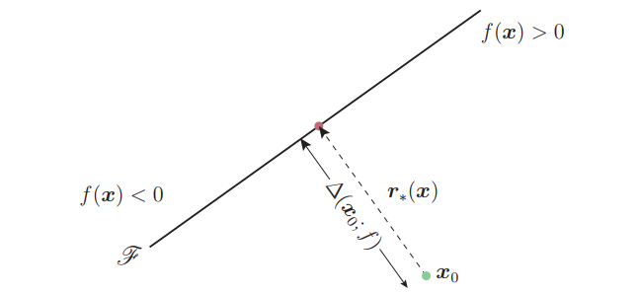


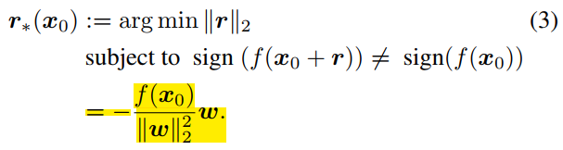
DeepFool
Binary Classifier → Linear Model → DeepFool
Notation:
Binary Classifier:
Original input image:
Estimated label:
Adversarial perturbation:
Binary Classifier output: {-1,1}
Linear Binary Classifier :
Separating Affine Hyperplane:
How to find adversarial perturbation:
Separating Hyperplane:分离超平面是指将两个不相交的凸集分割成两部分的一个平面。
Affine Transform:一个向量空间进行一次线性变换并接上一个平移。

Slide 9
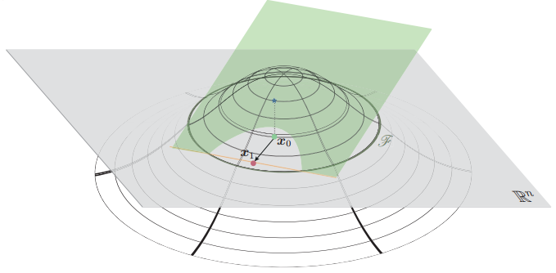
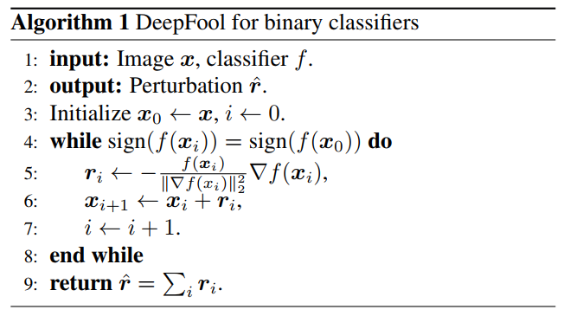




DeepFool
Binary Classifier → Iteration DeepFool
Gradient Descent
green plane :
wire-framed graph:
orange line:
$$f\left(x_{i}+r_{i}\right)$$
$$f\left(x_{0}\right)$$
=
$$f\left(x\right)=w^{T}x+b$$
$$∇_{x}f\left(x\right)=w^{T}$$
$$f\left(x_{i}+r_{i}\right)=w^{T}\left(x_{i}+r_{i}\right)+b=w^{T}x_{i}+w^{T}r_{i}+b=\left(w^{T}x_{i}+b\right)+w^{T}r_{i}=f\left(x_{i}\right)+w^{T}∙r_{i}=f\left(x_{i}\right)+∇_{x}f\left(x\right)∙r_{i}$$

Slide 10
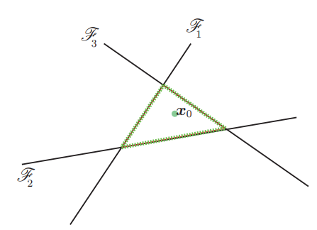






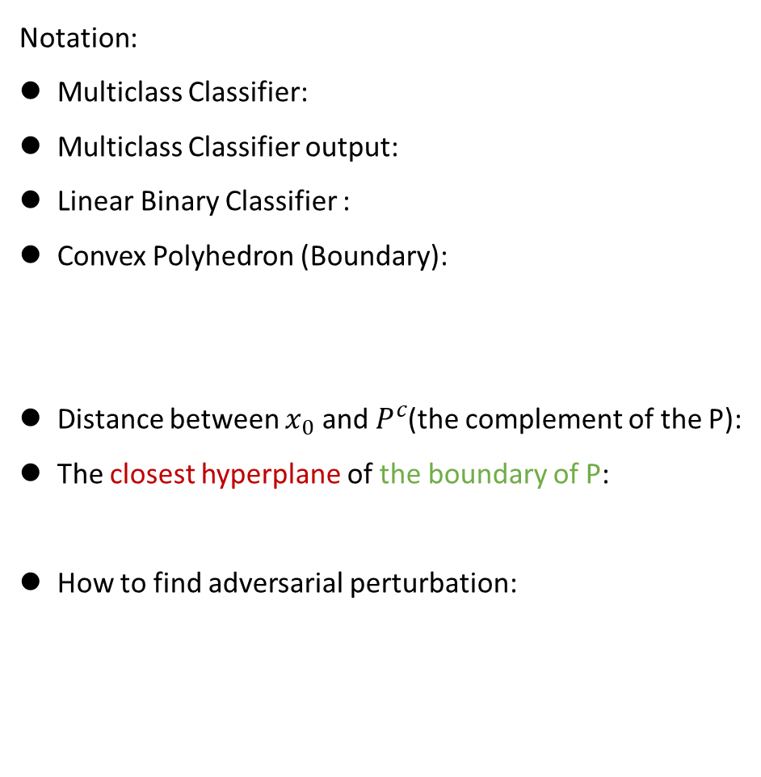

DeepFool
Multiclass Classifier → Linear Model (Affine)→ Iteration DeepFool
Assumption: 4 class. $x_{0}$ belong to Class 4.
Notation:
Multiclass Classifier:
Multiclass Classifier output:
Linear Binary Classifier :
Convex Polyhedron (Boundary):
Distance between $x_{0}$ and $P^{c}$(the complement of the P):
The closest hyperplane of the boundary of P:
How to find adversarial perturbation:
Class 3
Class 4
Class 4
Class 2
Class 1
Class 4
Here, $\hat{l}\left(x_{0}\right)=3$
P defines the region of the space where f outputs the label$kˆ(x_{0} ).$ $x_{0}$ is located inside $P$.

Slide 11
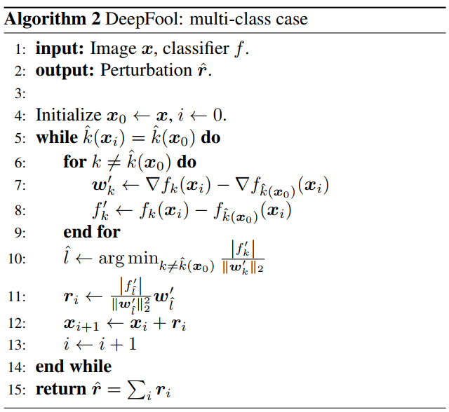
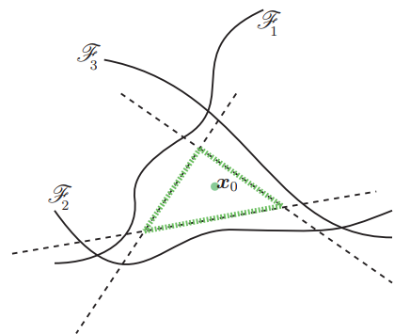






DeepFool
Multiclass Classifier → Nonlinear Model (General classifier) → Iteration DeepFool
Class 3
Class 4
Class 4
Class 2
Class 1
Class 4
green line: boundry
dashed lines:
用 来近似
用 来近似

Slide 12
JSMA
JSMA (iteration)
Feedforward NN(Shallow)
Multi-Layer Perceptron
Feedforward NN(Deep)
DNN
Single Pixel
Pixel Pair
Increase pixel
Decrease pixel
Increase pixels
Decrease pixels
https://arxiv.org/abs/1511.07528

Slide 13
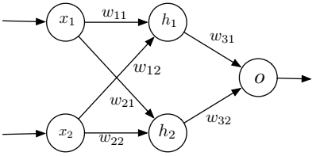
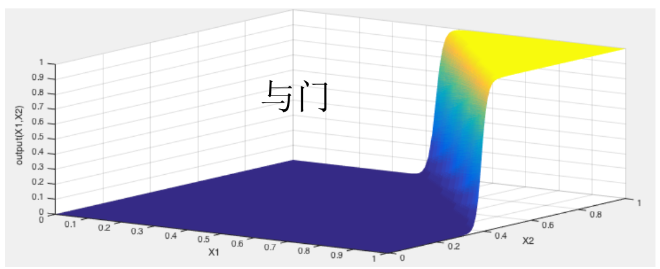


JSMA
Shallow Feedforward Neural Network→ Multi-Layer Perceptron(One Hidden layer)
Notation:
Feature vector:
Activation function:
Modeled Network:
Correct output:
Desired output:
Adversarial perturbation:
Adversarial Example:
Adversarial attack:
Forward derivative:
How to find perturbation:
Jacobian matrix
Jacobian matrix

Slide 14
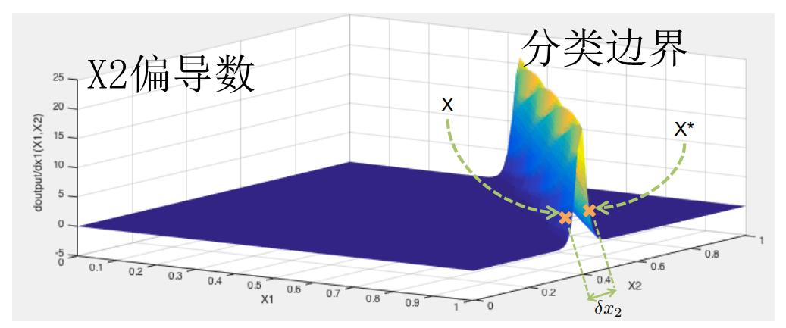

JSMA
Shallow Feedforward Neural Network→ Multi-Layer Perceptron(One Hidden layer)
$$\left(1,0.37\right)+\left(0,0.05\right)=(1,0.43)$$

Slide 15
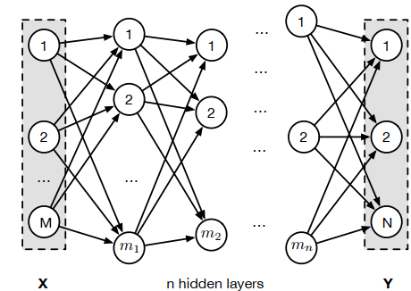


JSMA
Deep Feedforward Neural Network→ n Hidden layers
Notation:
Feature vector:
Modeled Network:
Forward derivative:
How to find perturbation:
What is the ？

Slide 16
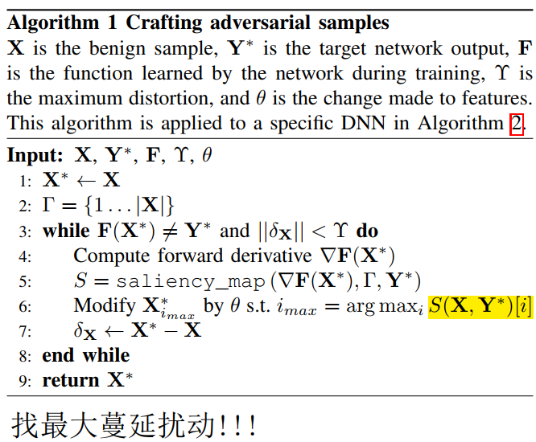


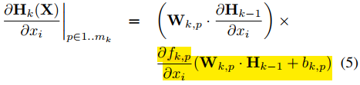

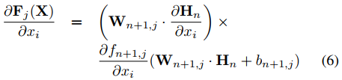

JSMA
Deep Feedforward Neural Network→ n Hidden layers
Compute Forward derivative（chain rule）：
gamma
upsilon
$$=$$

Slide 17

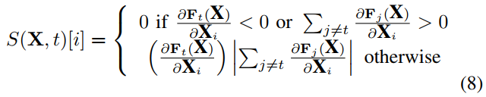


JSMA
Deep Feedforward Neural Network→ n Hidden layers
Notation:
idea:
Saliency Map Version 1：Use to increase feature $x_{i}$
Positive gradient: bigger → better
Negative gradient: smaller → better
Saliency Map Version 2：Use to decrease feature $x_{i}$
argmax
$$i^{∗}=argmax S(X,t)[i]$$
Positive gradient: smaller → better
Negative gradient: bigger → better

Slide 18
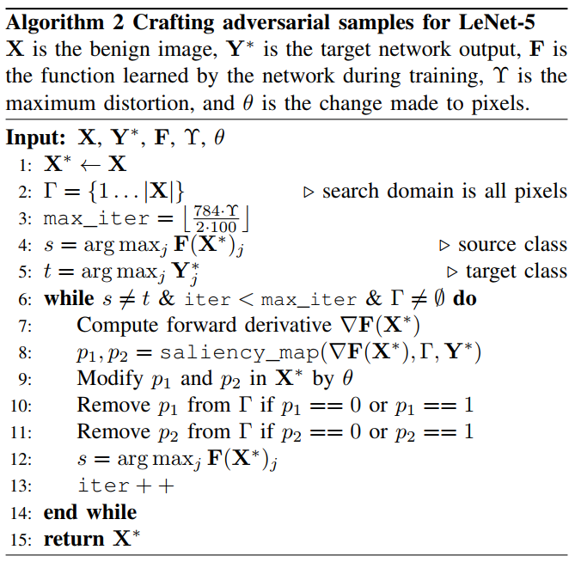

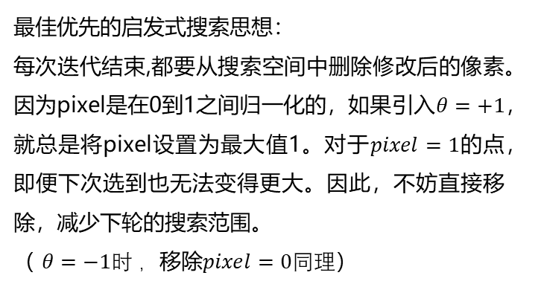
JSMA
Deep Feedforward Neural Network→ n Hidden layers
最佳优先的启发式搜索思想：
每次迭代结束,都要从搜索空间中删除修改后的像素。因为pixel是在0到1之间归一化的，如果引入$θ=+1$，就总是将pixel设置为最大值1。对于$pixel=1$的点，即便下次选到也无法变得更大。因此，不妨直接移除，减少下轮的搜索范围。
（ $θ=−1时 ，$移除$pixel=0同理$）

Slide 19
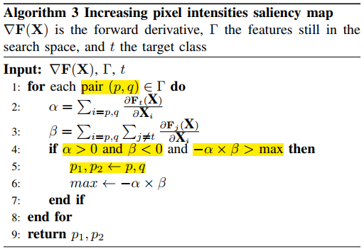


JSMA
Deep Feedforward Neural Network→ n Hidden layers
4

Slide 20
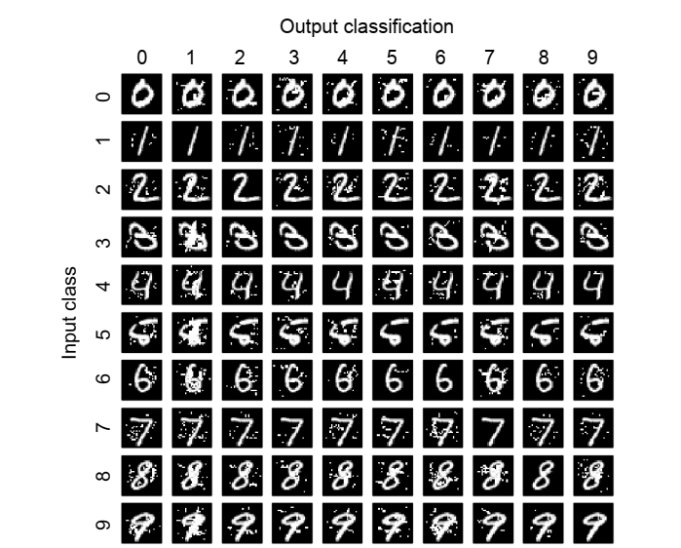
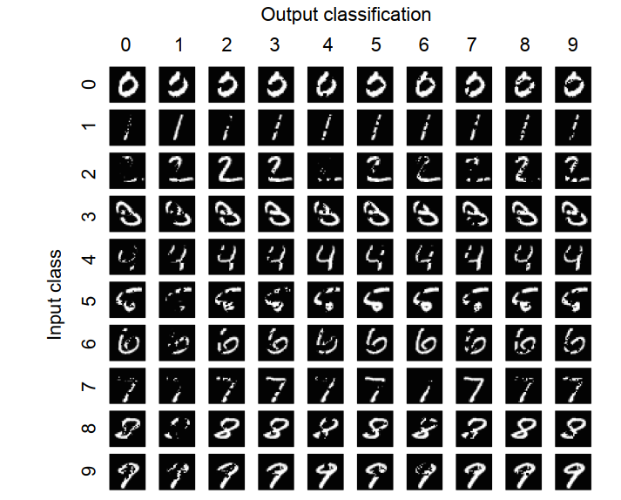
JSMA
Deep Feedforward Neural Network→ n Hidden layers
target class
target class
source class
source class
Increase pixel
Decrease pixel
Change much more pixel

Slide 21
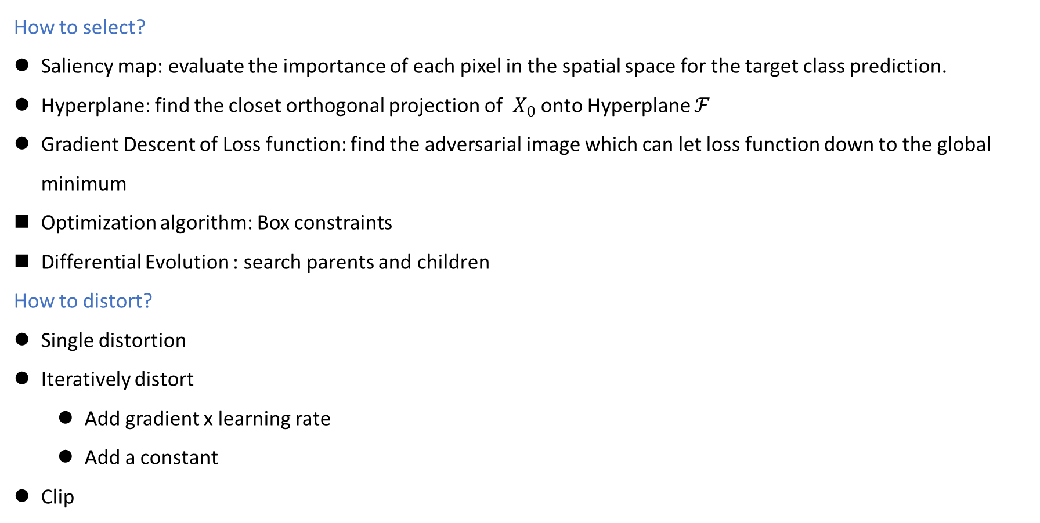
Conclusion
How to select?
Saliency map: evaluate the importance of each pixel in the spatial space for the target class prediction.
Hyperplane: find the closet orthogonal projection of $X_{0}$ onto Hyperplane $ℱ$
Gradient Descent of Loss function: find the adversarial image which can let loss function down to the global minimum
Optimization algorithm: Box constraints
Differential Evolution : search parents and children
How to distort?
Single distortion
Iteratively distort
Add gradient x learning rate
Add a constant
Clip

